Slide 1
USING SYNTHETIC DATA TO REDUCE DISCLOSURE RISK IN MUNICIPAL HEALTH SURVEYS
Stephen Immerwahr,
New York City Department of Health and Mental Hygiene
ASA/JSM
August 8, 2024
Notes:
Good morning. Today, I’ll be discussing our current work on leveraging synthetic data to mitigate disclosure risks in municipal health survey datasets.

Slide 2

PROJECT TEAM MEMBERS
Stephen Immerwahr
Fangtao He
Wendy Deng
Tashema Bholanath
Nneka Lundy De La Cruz
Monika Hu
Acknowledgement:
Amber Levanon-Seligson
Steven Fernandez
Sungwoo Lim
2
Notes:
This collaborative effort involves colleagues from the NYC Health Department and consultant Jingchen (Monika) Hu from Vassar College.

Slide 3
TALK ROADMAP
BACKGROUND
01
MITGATION SOLUTIONS & RESULTS
03
DISCLOSURE RISK ASSESSMENT
02
SUMMARY & TAKEAWAYS
04
3
Notes:
For this talk, I will first provide an overview of the project’s background. Then outline our method for assessing and mitigating disclosure risk, describe its application to the 2021 CHS, and end by discussing practical considerations and sharing key takeaways.

Slide 4

01
BACKGROUND
Notes:
Let’s begin with an overview of our project's background.

Slide 5
PUBLIC-USE DATA: USEFULNESS AND CHALLENGES
Public-use data files are valuable
Disclosure risks may exist in the public release of record-level survey data
5
Notes:
Local government agencies, like the NYC Health Department, routinely conduct health surveys to improve population health.
While sharing this data with the public is essential, it presents the challenge of protecting respondents’ confidentiality while maximizing the utility of record-level data.
One notable concern is the potential risk of re-identification through cross-referencing survey data with other administrative databases.

Slide 6
PROJECT OBJECTIVES
Systematic methods to:
EVALUATE DISCLOSURE RISKS
IMPLEMENT MITIGATION SOLUTIONS
EVALUATE RISK REDUCTION, UTILITY
6
Notes:
Our project aims to establish systematic procedures for assessing disclosure risks, implementing effective mitigation solutions, and evaluating both the remaining disclosure risk associated with the protected data and its utility for public health.

Slide 7


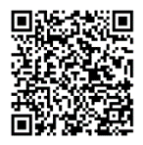
NYC COMMUNITY HEALTH SURVEY (CHS) OVERVIEW
Annual cross-sectional health surveillance survey of ≈ 10,000 NYC adults
Monitors progress towards citywide health initiatives and other core surveillance efforts
Collects information including health status, mental health, healthcare access, chronic diseases, health and risk behaviors, and social determinants of health
7
Notes:
We applied our risk assessment and mitigation strategies to the 2021 Community Health Survey or CHS, an annual health surveillance survey that gathers data from around 10,000 adult residents of New York City.

Slide 8
02
DISCLOSURE RISK ASSESSMENT
Notes:
Now, let’s explore our risk assessment strategy.

Slide 9
APPROACH OVERVIEW
Evaluate disclosure risk of all CHS 2021 survey records
Assume the intruder knows a combination of identifying variables of each record
Concern: Identifying a person in the NYC population within the CHS data set, compromising confidentiality and yielding additional, potentially sensitive information.
Identity Disclosure
Risk
Flag high-risk records using identifying categorical variables and sampling weights
Weighted N (WgtN) and 95% Confidence Intervals (CIs) – focus on population total estimates and their standard errors
9
Notes:
Disclosure risk is the possibility of a malicious intruder being able to correctly identify a person in the NYC population using information (such as identifying variables) from the public use CHS dataset.
To pinpoint high-risk records, we focused on evaluating disclosure risk of all survey records, assuming intruders could leverage unique variable combinations for re-identification.
Our risk assessment strategy involved flagging high-risk records using the Weighted N method, which analyzes aggregate population totals and associated 95% confidence intervals. Note that the Weighted N method will find a larger share of high-risk records in larger survey data sets, as each record represents fewer individuals in the sampled population

Slide 10
SELECTION OF IDENTIFYING VARIABLES
CORE VARIABLES
    Demographic variables that are easily knowable: age group, sex, race/ethnicity
    Geography (Borough)
    High priority to be kept unmodified for use by analysts
KEY VARIABLES
    Additional demographic and health-related variables that are easily knowable
    Containing sensitive information; subject to mitigation solutions
10
Notes:
We categorized these identifying variables into Core and Key variables.
Core Variables:
Primarily demographic variables or quasi-identifying variables.
These variables are prioritized to remain unmodified for release as they are commonly used for analysis.
Key Variables:
Comprise additional demographic and health-related variables that are potentially identifiable or easily known.
These variables are designated for release but with a lower priority to remain unmodified. They do contain sensitive information and are therefore subject to mitigation solutions aimed at reducing disclosure risk.
Other variables may be knowable but not necessarily accurately known and are therefore not considered as Key variables.

Slide 11
03
MITIGATION SOLUTIONS & RESULTS
Notes:
Let's shift our focus to the risk evaluation and mitigation solutions as applied to the 2021 CHS

Slide 12
IDENTIFYING HIGH-RISK RECORDS
Core + Key variable
(one Key at a time)
Age Group x Sex x Race/ethnicity x Borough x Key Variable a
Weighted N (population) less than 100 flagged as high-risk
Weighted N method - i.e., the estimated population of these records in this combination are less than 100
25 Key variables identified elevated risk of re-identification
11
Notes:
For the 2021 CHS, we strategically selected four Core demographic variables: age group, sex at birth, race/ethnicity, and borough of residence. Additionally, we identified 25 Key variables characterized by an elevated risk of re-identification, after in-depth review among subject matter experts.
For each of the 25 combinations of Core and Key variables, records in cells with a Weighted N of fewer than 100 individuals (using the lower bound of the 95% confidence interval) were identified as high-risk.
Note that all Key variables used here are categorical, and most (but not all) are dichotomous. For the dichotomous variables, we’re testing 4 age x 2 sex x 5 race x 5 boroughs x 2 responses = 400 cells. But some Key variables -- like education -- have more than 2 categories

Slide 13


RISK ASSESSMENT RESULTS
Of the 25 Key variables selected –
400-2,442
high-risk observations out of 10,271 records
4%-24%
(of all observations) with elevated risk of re-identification
12
Notes:
The 2021 CHS dataset contains a total of 10,271 individual records.
In our analysis of the 25 Key variables, we identified between 400 and 2,442 records as high-risk for re-identification, approximately 4% to 24% of the total records.
These observations met the specific risk criterion where the lower bound of 95% CI of the Weighted N fell below 100.

Slide 14
MITIGATION SOLUTIONS
Suppression
Partial Synthesis – DPMPM
Partial Synthesis – CART
Applied to Key variables for high-risk records
Method: set values to missing
Introduces additional missing values in dataset, and thus not considered
Applied to Key variables for high-risk records
Method: synthesize new value using nonparametric Bayesian models
Applied to Key variables for high-risk records
Method: synthesize new value using classification and regression models
14
Notes:
We explored three mitigation methods: suppression and two synthesis methods – the Dirichlet Process Mixture of Multinomial Distributions Model (DPMPM) and the Classification and Regression Tree (CART) method.
Suppression involves recoding high-risk observations to missing values. However, we aimed to avoid this method to maximize the utility of the published data.
Between the two synthesis methods, DPMPM synthesizes new values using nonparametric Bayesian models for multivariate unordered categorical data, while CART synthesizes new values using classification and regression tree models.
While we will delve into a comparison of CART and DPMPM in a subsequent slide, for the remainder of this presentation, we will focus on the DPMPM mitigation approach. This approach was selected for its balance between risk reduction and utility preservation.

Slide 15
OVERVIEW OF OUR APPROACH
MITIGATION SOLUTION
SUBSET OF HIGH-RISK RECORDS
(RE)EVALUATE RISK,
ASSESS DATA UTILITY
CONFIDENTIAL DATA
SYNTHETIC DATA
PROTECTED PUBLIC-USE DATA
Partial data synthesis with DPMPM – a Bayesian latent class model
Determine a threshold (e.g., 5% of all records)
A randomized process
95% CI Overlap and MSE of prevalence estimates of selected health measures
15
Notes:
With DPMPM, the values of high-risk records for variables were substituted with synthetic values simulated through statistical modeling.
We termed this “partial data synthesis’ because within each Key variable we replaced a "subset“ of high-risk records with synthetic values to balance risk control and data utility. The selection of this subset was randomized to ensure that no particular subpopulation was systematically included in the mitigation process.
After applying mitigation solution, we evaluated the disclosure risk and the utility of the protected data, the latter by calculating the 95% Confidence Interval Overlap and Mean Square Error of the prevalence estimates between the original and treated dataset.

Slide 16
RISK RESULTS AFTER DPMPM SYNTHESIS
Before Synthesis
4% to 24% high-risk
observations of all observations
After Synthesis
At most 21% of the dataset
remains classified as high-risk
(i.e., at least 79% protection)
Synthesis-at-most-5% method
Note: among 25 Key variables selected in the 2021 CHS
16
Notes:
Here are some key results from applying DPMPM:
Recall, prior to synthesis, among the 25 selected Key variables, the proportion of high-risk observations ranges from 4% to 24% of all observations.
Employing a synthesis-at-most-5% method, at most 21% of the Key variable observations remains high-risk after synthesis, that is, a 3 percentage point reduction from before synthesis using the Weighted N method. This means that the synthesis process yielded a protected dataset with at least 79% protection, as calculated by Weighted N.

Slide 17
DATA UTILITY AFTER DPMPM SYNTHESIS
With synthesis-at-most 5%
SYNTHESIS
Thresholds: 5%, 10%, 20%
HEALTH MEASURES
10 commonly reported
95% CONFIDENCE INTERVAL OVERLAP
Cutoffs: 50%, 75%, 90%
94%
overlap in the 95% confidence intervals of important health measures, on average
Best in balancing risk reduction
and utility preservation
17
Notes:
In terms of data utility, the resulting synthetic dataset preserved a high level of utility – for commonly reported health measures. It achieves an average overlap of at least 94% between the confidence intervals from the original dataset and those from the synthetic version.
Although we presented the results from the synthesis-at-most-5%, we also experimented with the thresholds of 10% and 20%, using both DPMPM and CART, as well as suppression. We judged DPMPM synthensis-at-most-5% as best at balancing risk reduction and utility preservation.

Slide 18
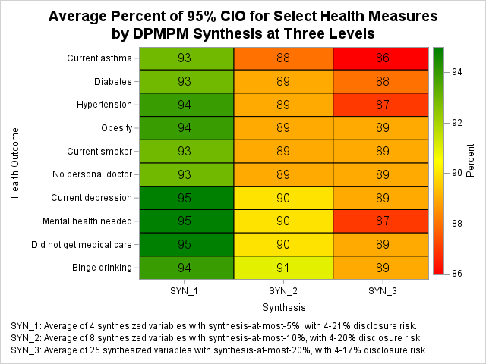
CI OVERLAP DECLINES WITH SYNTHESIS
18
Notes:
Here is a graphical representation of the average confidence interval overlap for select health measures after DPMPM synthesis at three different levels – at most: 5%, 10%, and 20%. In these scenarios, 4, 8, and 25 variables, respectively, contained synthetic data. Despite increasing the proportion of synthetic records, the risk after synthesis decreased only slightly from 21% to 20%, and finally to 17%.

Slide 19
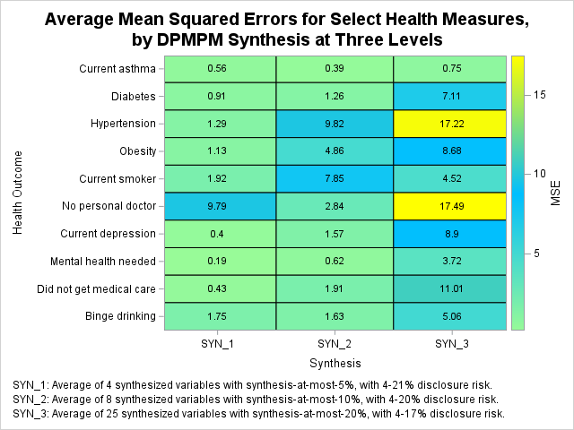
MSE INCREASES WITH SYNTHESIS
19
Notes:
As mentioned, in addition to the confidence interval overlap we looked at the mean squared error. Here’s the average MSE at the same 3 levels of synthesis. We see that synthesis-at-most-5% has the lowest average MSE across the 10 selected health measures, on average.

Slide 20
RISK AND UTILITY: DPMPM vs CART
Disclosure risk (y-axis)
  % of high-risk after mitigation
  Smaller means lower risk
Utility (x-axis)
  95% CIO of health outcomes before and after mitigation
  Larger means higher utility
Utility-risk trade-off
Final choice
  DPMPM (overall higher utility at the price of slightly higher disclosure risks)
ο Variable A
Variable B
Δ Variable C
◊ Variable D
20
Notes:
Now, let’s compare the DPMPM and CART mitigation approaches. In the chart displayed, we've plotted the risk-utility comparison for four variables that underwent mitigation solutions with synthesis-at-most-5% under both methods – DPMPM represented in gray and CART in orange.
On the y-axis, we have the percentage of high-risk records after mitigation. On the x-axis, we depict utility, which represents the interval overlap of health outcomes before and after mitigation. Therefore, a smaller percentage of disclosure risk (toward the bottom of the y-axis) indicates lower risk, while a larger percentage of utility (toward the right of the x-axis) signifies higher utility.

Slide 21
RISK AND UTILITY: DPMPM vs CART
Disclosure risk (y-axis)
  % of high-risk after mitigation
  Smaller means lower risk
Utility (x-axis)
  95% CIO of health outcomes before and after mitigation
  Larger means higher utility
Utility-risk trade-off
Final choice
  DPMPM (overall higher utility at the price of slightly higher disclosure risks)
less good
ο Variable A
Variable B
Δ Variable C
◊ Variable D
more good
20
Notes:
In evaluating these results, we’re looking for lower disclosure risk and high utility. Comparing DPMPM and CART, DPMPM generally provides higher utility (on the x-axis) with only slightly higher (or similar) disclosure risk (height on the y-axis).

Slide 22
04
SUMMARY AND TAKEAWAYS
Notes:
To conclude, I’d like to share some lessons learned and key takeaways from our experience.

Slide 23




CONSIDERATIONS IN PRACTICE
TIMING FOR MITIGATION IMPLEMENTATION
SCOPE OF DATA FOR MITIGATION
RETROTRATIVE MITIGATION
HANDLING USER INQUIRIES
22
Notes:
Our project offers several practical considerations:
Firstly, timing for mitigation implementation is important. Should mitigation strategies be incorporated from a project's inception, or is it feasible to defer them until the data is being prepared for public release?
Next, consider the scope of data for mitigation. Should this approach be universally applied to all datasets, focused exclusively on extensive survey datasets, or should we consider multiple versions of datasets?
Another significant consideration is retroactive mitigation. This raises questions about whether all historical datasets, including internal and publicly released ones, should undergo these processes to align with current data privacy standards.
Establishing a clear protocol for addressing user inquiries is important, especially when discrepancies arise between synthetic data estimates and those published by the Health Department is essential. Crafting a transparent and informative response strategy is key to maintaining trust and credibility.

Slide 24
SUMMARY AND KEY TAKEAWAYS
Any mitigation presents a risk-utility trade-off
Selecting potentially identifying variables is complex
Weighted N is useful approach to quantify risk
Multiple considerations in setting parameters
1
2
3
4
23
Notes:
Here are some key takeaways from our experience:
The Weighted N method effectively quantifies risk. An empirical method is easier to replicate than an ad hoc one
Mitigation involves trade-offs between utility and risk, necessitating careful evaluation and documentation
Selecting Core and Key variables is complex, involves many concerns, and will be different for each survey
There are multiple considerations in setting parameters, such as the 100 in the Weighted N method for flagging high-risk records and determining the percentage of high-risk observations to be synthesized (e.g., up to 5%)

Slide 25
REFERENCES
Drechsler, J. (2011), Synthetic Datasets for Statistical Disclosure Control, Springer: New York.
Grant-Chapman, H. and Vallee, H. Q. (2022), Making government data publicly available: guidance for agencies on releasing data responsibly, Center for Democracy and Technology.
Hu, J., Reiter, J. P., and Wang, Q. (2014), Disclosure risk evaluation for fully synthetic categorical data, Privacy in Statistical Databases, J. Domingo-Ferrer (ed), 185-199.
Hu, J. and Savitsky, T. D. (2023), Bayesian data synthesis and disclosure risk quantification: an application to the Consumer Expenditure Surveys, Transactions on Data Privacy, 16, 83-121.
Little, R. J. A. (1993), Statistical analysis of masked data, Journal of Official Statistics, 9(2), 407-426.
Reiter, J. P. and Mitra, R. (2009), Estimating risks of identification disclosure in partially synthetic data, The Journal of Privacy and Confidentiality, 1, 99-110.
Simon, G., Shortreed, S. M., Coley, R. Y., Iturralde, E. M., Platt, R., Toh, S., and Ahmedani, B. (2020), Toolkit for assessing and mitigating risk of re-identification when sharing data derived from health records, Sentinel.
Snoke, J., Raab, G. M., Nowok, B., Dibben, C., and Slavkovic, A. (2018), General and specific utility measures for synthetic data, Journal of Royal Statistical Society, Series A, 181, 663-688.
24
Notes:
Here are a few selected references that informed our project.

Slide 26
NEXT STEPS
DECIDE ON DATASETS FOR TREATMENT
IMPLEMENT MITIGATION SOLUTIONS
UPLOAD TO PUBLIC-FACING WEBSITE
25

Slide 27
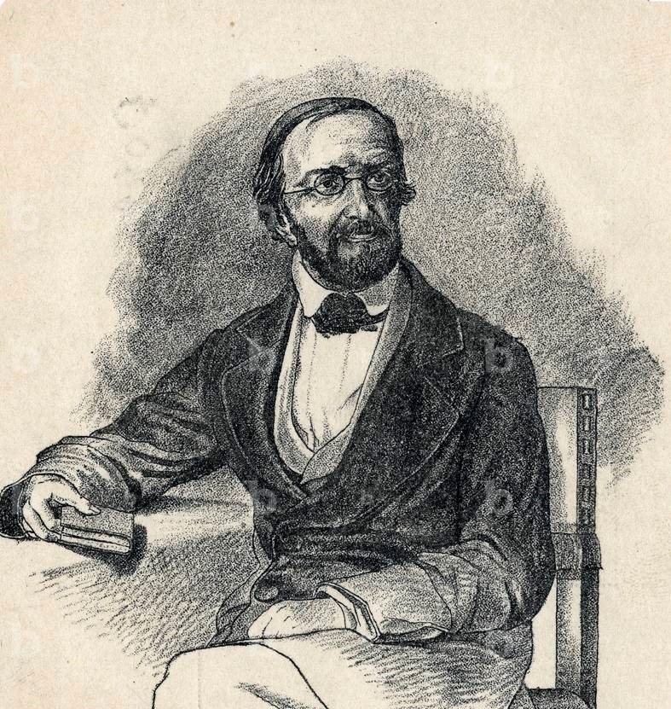
Johann Peter Gustav Lejeune Dirichlet (1805 – 1859)
Notes:
This brings us to the end of my presentation. Thank you.

Slide 28
Thank you for your attention.
Questions?
Notes:
This brings us to the end of my presentation. Thank you.

